Slide 1
Identifying differences in the omics of IR and IS prediabetics
Sabrina de Oliveira - I6155125
BMS Bachelor thesis 2020
Bigcat
Maastricht university

Slide 2

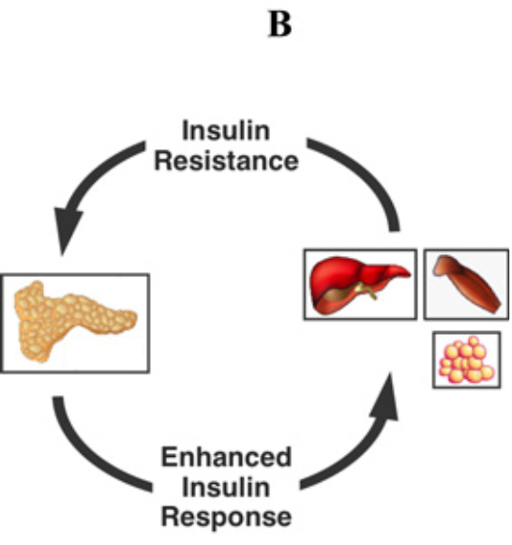
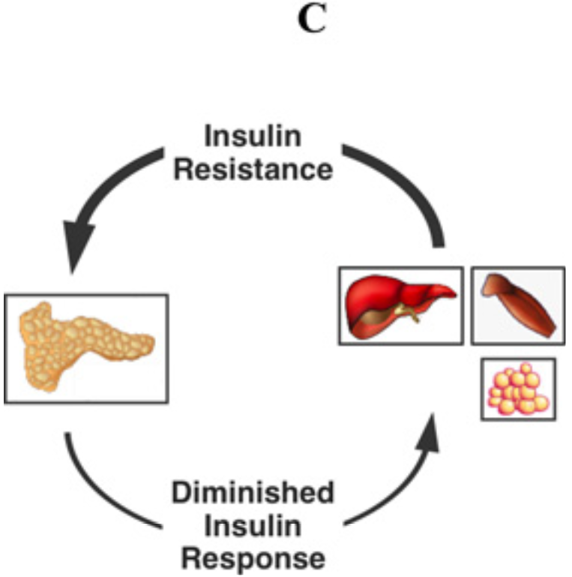
Introduction: T2DM
Importance:
2019: 463 million adults 2045: 700 million adults (1).
90-95% of all diabetes (2).
Pathophysiology:
Importance of researching factors influencing IR.
51%
(3)
Notes:
Pathophysiology:
https://www.ncbi.nlm.nih.gov/pmc/articles/PMC4226760/
T2DM is generally believed to develop

Slide 3
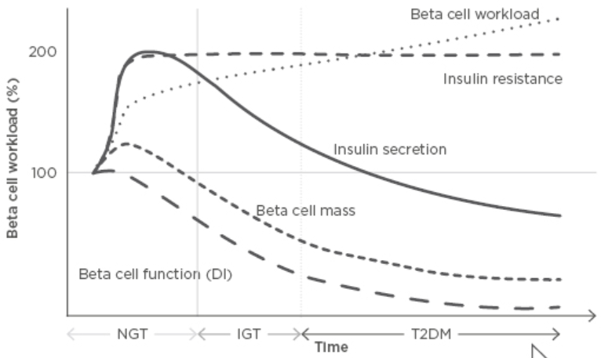
Introduction: T2DM
Importance:
2019: 463 million adults 2045: 700 million adults (1).
90-95% of all diabetes (2).
Pathophysiology:
51%
(3)
Notes:
Pathophysiology:
https://www.ncbi.nlm.nih.gov/pmc/articles/PMC4226760/
https://www.emjreviews.com/diabetes/article/editors-pick-how-can-we-develop-more-effective-strategies-for-type-2-diabetes-mellitus-prevention-a-paradigm-shift-from-a-glucose-centric-to-a-beta-cell-centric-concept-of-diabetes/
T2DM is generally believed to develop after the onset of insulin resistance due to the beta cell dysfunction that results from the increased need for insulin secretion. This beta cell dysfunction is especially relevant since no production of new beta cells occurs past the age of 30 in the human pancreas. Hence, insulin resistance is believed to be a critical step in the development of T2DM. For this reason, great efforts are being made in order to investigate factors that influence insulin resistance and which are involved in insulin sensitivity.

Slide 4

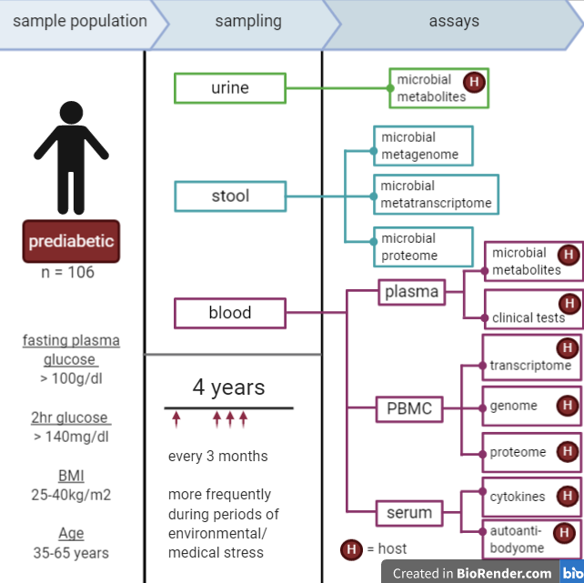
Introduction: The iHMP T2DM project
Sample population and general sampling protocol of the iHMP’s T2DM project. PBMC = peripheral blood monocytes. Figure adapted from an iHMP Research Network Consortium publication (4).

Slide 5

Introduction: present knowledge concerning IR vs IS
Metabolome:
IR = component of metabolic syndrome & is linked to…
Dyslipidaemia (5)
Unrestrained gluconeogenesis (5)
Unrestrained proteolysis (6)
Proteome:
Differential expression of genes involved in BCAA catabolism (7)
Downregulation of PPAR-gamma (8)
Microbial metagenome:
Specific taxa = associated with improved insulin sensitivity or with insulin resistance (9)
Notes:
Nevertheless, this interaction is still poorly understood and the changes in the omics of type 2 diabetic individuals remain debatable, especially in the time-period prior to diabetes onset.

Slide 6

Aim
Investigate the changes in the host proteome and host metabolome as well as to the microbiome of insulin resistant individuals at high risk for diabetes compared to that of insulin sensitive individuals at high risk for diabetes.

Slide 7










Methods
Proteome data
Metabolome data
Metagenome data
iHMP T2DM data
Pre-processing
Isolated analysis of each omic
Combined analysis
Network Analysis
(Cytoscape)
Pathway analysis
(PathVisio & MetaboAnalyst)
Taxon Set Enrichment Analysis
Subject data
Classification and data availability
60 subjects:
28 = IS
32 = IR
Differential Analysis
(limma package)
Combined analysis
Average per subject
Differential Analysis
(MetaboDiff package)
Excl. of outliers
Filtering taxa (NA ranks & prevalence)
Average per subject
only HMDB included
Rerun 4
Top taxa
Shannon diversity
Phyla abundance
Add classifications
Incl. only classified
PCoA & PERMANOVA
Creating consistent datasets
CCA & PCA
Rerun taxa filtering, CCA & PCA

Slide 8

Results: 2 & 3 Differential Analysis
Proteomic
Metabolomic
686 samples
302 proteins
726 samples
323 metabolites
P-value < 0.05: 23 proteins
Upregulated (logFC > 0): 13 proteins.
Downregulated (logFC < 0): 10 proteins
P-value < 0.05: 40 metabolites
Upregulated (logFC > 0): 19 metabolites.
Downregulated (logFC < 0): 21 metabolites.

Slide 9

Methods
Proteome data
Metabolome data
Metagenome data
iHMP T2DM data
Pre-processing
Isolated analysis of each omic
Combined analysis
Network Analysis
(Cytoscape)
Pathway analysis
(PathVisio & MetaboAnalyst)
Taxon Set Enrichment Analysis
Subject data
Classification and data availability
Differential Analysis
(limma package)
Combined analysis
Average per subject
Differential Analysis
(MetaboDiff package)
Excl. of outliers
Filtering taxa (NA ranks & prevalence)
Average per subject
only HMDB included
Rerun 4
Top taxa
Shannon diversity
Phyla abundance
Add classifications
Incl. only classified
PCoA & PERMANOVA
Creating consistent datasets
CCA & PCA
Rerun taxa filtering, CCA & PCA

Slide 10

Results: 5 Combined Pathway Analysis
PathVisio
Expression criterion: p < 0.05
MetaboAnalyst
KEGG (2019)
15 metabolites
25 proteins
Ran all p < 0.05
(39 metabolites and 25 proteins)
18 significantly more changed pathways (Z-score > 1.96)
Only 1 – 2 hits.
None with proteins & metabolites.
3 with Z-score < 1.96 but more hits (3-5 hits)
All hits = proteins.
6 significantly altered pathways (p < 0.05)
Generated different pathways to PathVisio (except for glutathione metabolism).
4 pathways had 2 hits and 2 pathways had 1 hit.
All hits = metabolites.
Notes:
CHECK 15 METABOLITES? WHY NOT 40?

Slide 11
Results: 5 Combined Pathway Analysis
PathVisio
Expression criterion: p < 0.05
MetaboAnalyst
KEGG (2019)
Pathway | Hits | logFC
IL-1 signalling | IL1RAP | 0.283
Signal transduction through IL1R | IL1RAP | -0.302
Sphingolipid pathway | Dihydro-sphingosine | -0.155
PPAR alpha pathway | APOA1 PLTP | -0.301 -0.458
Glutathione metabolism | L-Glutamate 5-Oxoproline | 0.288 0.157
Pathway | Hits | logFC
Sphingolipid metabolism | Sphinganine Sphingomyelin | -0.153 -0.332
Glutathione metabolism | L-Glutamate 5-Oxoproline | 0.288 0.157
D-Glutamine and D-glutamate metabolism | L-Glutamate | 0.288
Nitrogen metabolism | L-Glutamate | 0.288
Notes:
CHECK 15 METABOLITES? WHY NOT 40?

Slide 12

Methods
Proteome data
Metabolome data
Metagenome data
iHMP T2DM data
Pre-processing
Isolated analysis of each omic
Combined analysis
Network Analysis
(Cytoscape)
Pathway analysis
(PathVisio & MetaboAnalyst)
Taxon Set Enrichment Analysis
Subject data
Classification and data availability
Differential Analysis
(limma package)
Combined analysis
Average per subject
Differential Analysis
(MetaboDiff package)
Excl. of outliers
Filtering taxa (NA ranks & prevalence)
Average per subject
only HMDB included
Rerun 4
Top taxa
Shannon diversity
Phyla abundance
Add classifications
Incl. only classified
PCoA & PERMANOVA
Creating consistent datasets
CCA & PCA
Rerun taxa filtering, CCA & PCA

Slide 13

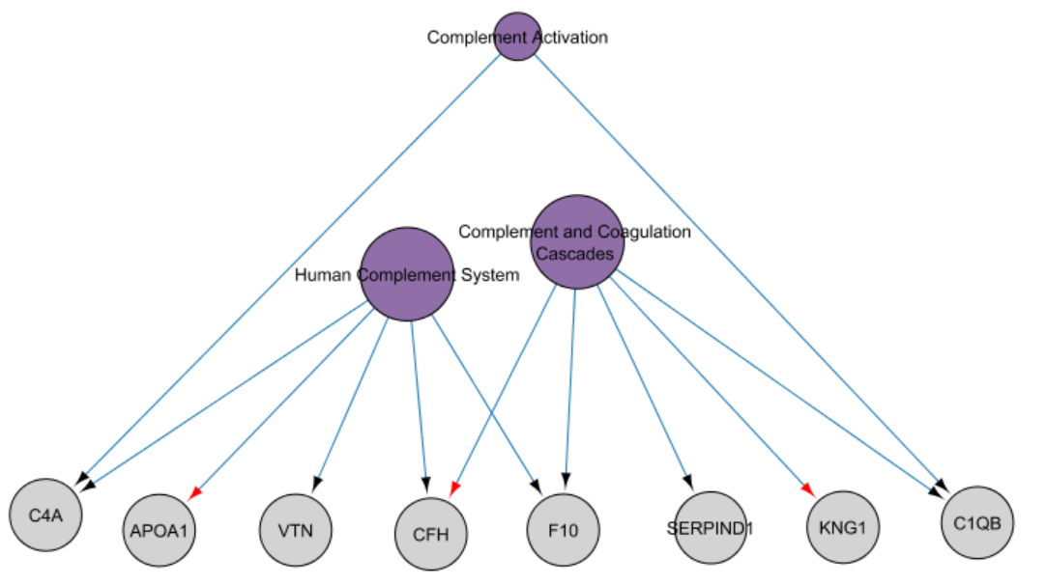
Results: 6 Network Analysis
Pathways = purple, proteins (HGNC annotation) = grey.
Size of the pathway nodes represents their out-degree size.

Slide 14
Methods
Proteome data
Metabolome data
Metagenome data
iHMP T2DM data
Pre-processing
Isolated analysis of each omic
Combined analysis
Network Analysis
(Cytoscape)
Pathway analysis
(PathVisio & MetaboAnalyst)
Taxon Set Enrichment Analysis
Subject data
Classification and data availability
Differential Analysis
(limma package)
Combined analysis
Average per subject
Differential Analysis
(MetaboDiff package)
Excl. of outliers
Filtering taxa (NA ranks & prevalence)
Average per subject
only HMDB included
Rerun 4
Top taxa
Shannon diversity
Phyla abundance
Add classifications
Incl. only classified
PCoA & PERMANOVA
Creating consistent datasets
CCA & PCA
Rerun taxa filtering, CCA & PCA

Slide 15

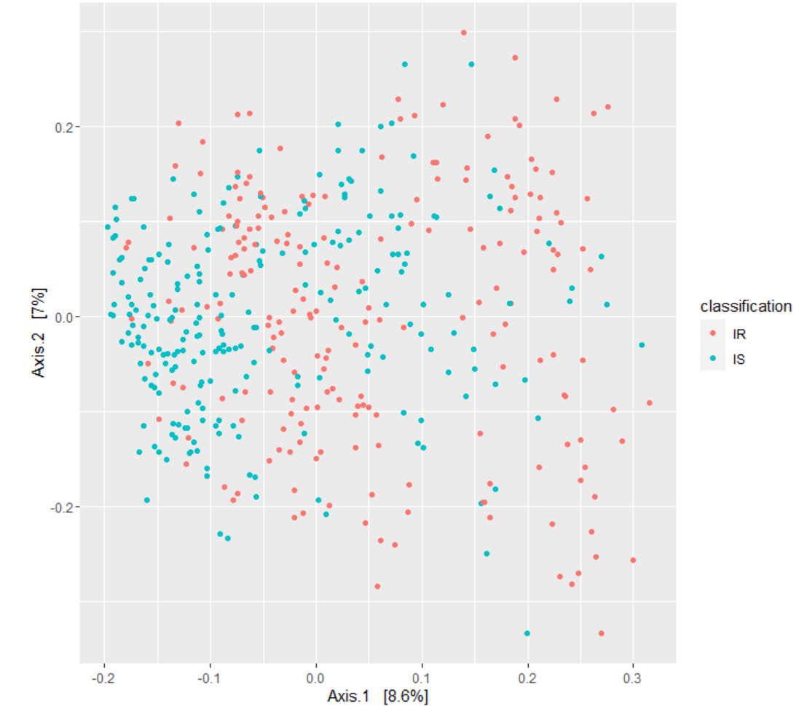
Results: 4 PCoA & PERMANOVA
PERMANOVA
p = 0.01
R2 = 0.019
Check of homogeneity:
p = 0.678
Notes:
Check if groups are homogenous based on p-value!

Slide 16
Methods
Proteome data
Metabolome data
Metagenome data
iHMP T2DM data
Pre-processing
Isolated analysis of each omic
Combined analysis
Network Analysis
(Cytoscape)
Pathway analysis
(PathVisio & MetaboAnalyst)
Taxon Set Enrichment Analysis
Subject data
Classification and data availability
Differential Analysis
(limma package)
Combined analysis
Average per subject
Differential Analysis
(MetaboDiff package)
Excl. of outliers
Filtering taxa (NA ranks & prevalence)
932 taxa
Average per subject
only HMDB included
Rerun 4
Top taxa
Shannon diversity
Phyla abundance
Add classifications
Incl. only classified
PCoA & PERMANOVA
441 samples
Creating consistent datasets
CCA & PCA
Rerun taxa filtering, CCA & PCA

Slide 17
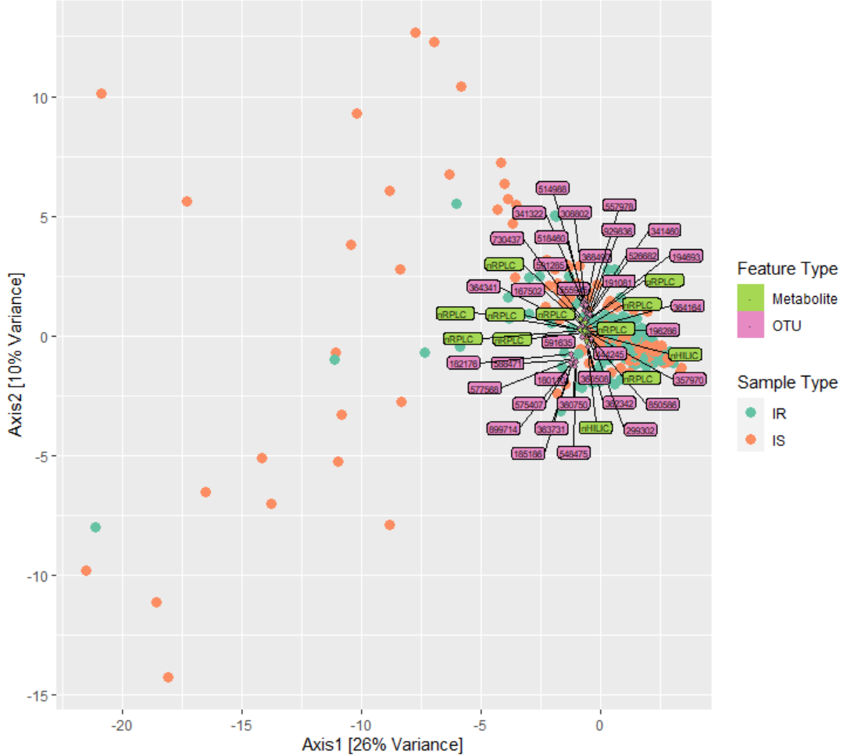
Results: 7 CCA & PCA
CCA
35 microbes
12 metabolites
Correlation coefficient = 0.509
Best explanatory features of covariation in the data of each classification

Slide 18
Methods
Proteome data
Metabolome data
Metagenome data
iHMP T2DM data
Pre-processing
Isolated analysis of each omic
Combined analysis
Network Analysis
(Cytoscape)
Pathway analysis
(PathVisio & MetaboAnalyst)
Taxon Set Enrichment Analysis
Subject data
Classification and data availability
Differential Analysis
(limma package)
Combined analysis
Average per subject
Excl. of outliers
Differential Analysis
(MetaboDiff package)
441 samples
Filtering taxa (NA ranks & prevalence)
Average per subject
only HMDB included
Rerun 4
Top taxa
Shannon diversity
Phyla abundance
Add classifications
Incl. only classified
PCoA & PERMANOVA
Creating consistent datasets
CCA & PCA
Rerun taxa filtering, CCA & PCA

Slide 19
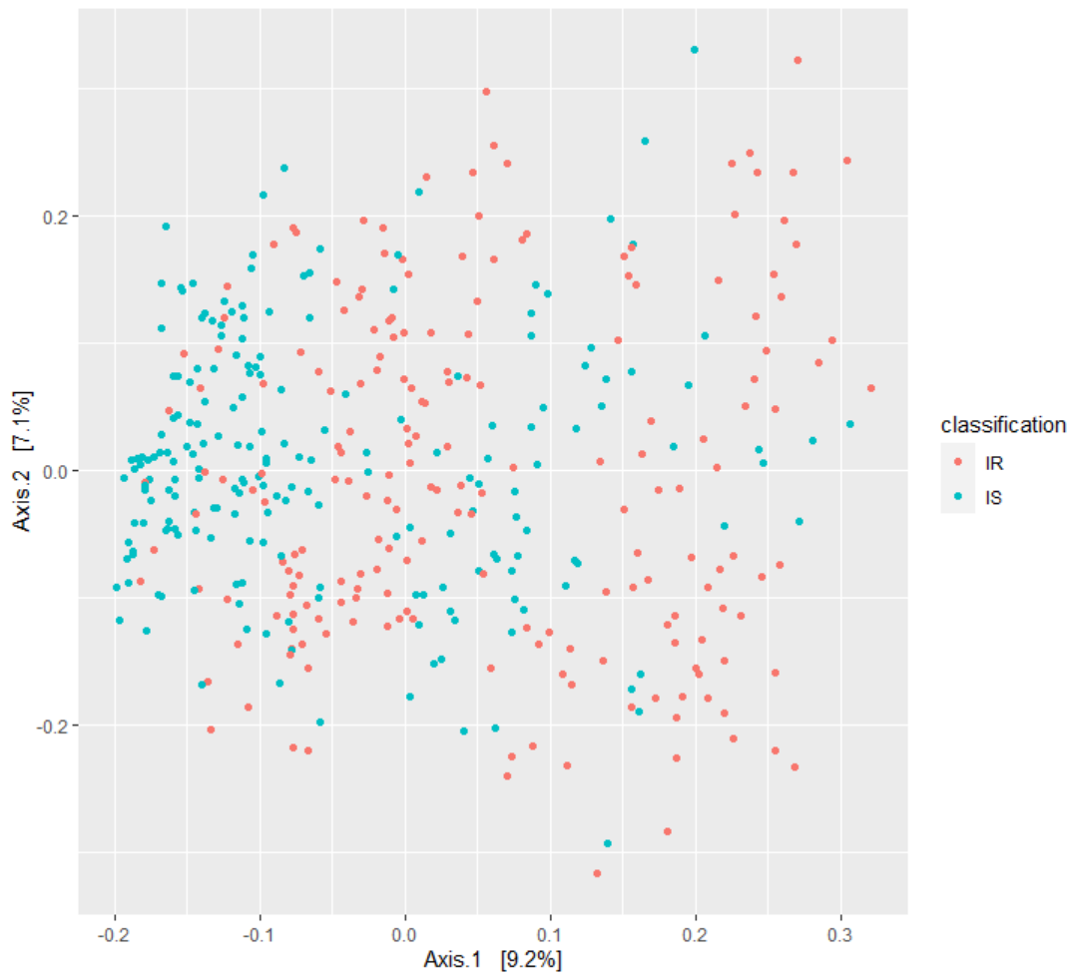
Results: 8 Excl. of outliers metagenome results
Old:
New:
PERMANOVA
Old | p = 0.010 R2 = 0.019
New | p = 0.010 R2 = 0.021
Check of homogeneity
Old | p = 0.678
New | p = 0.542

Slide 20
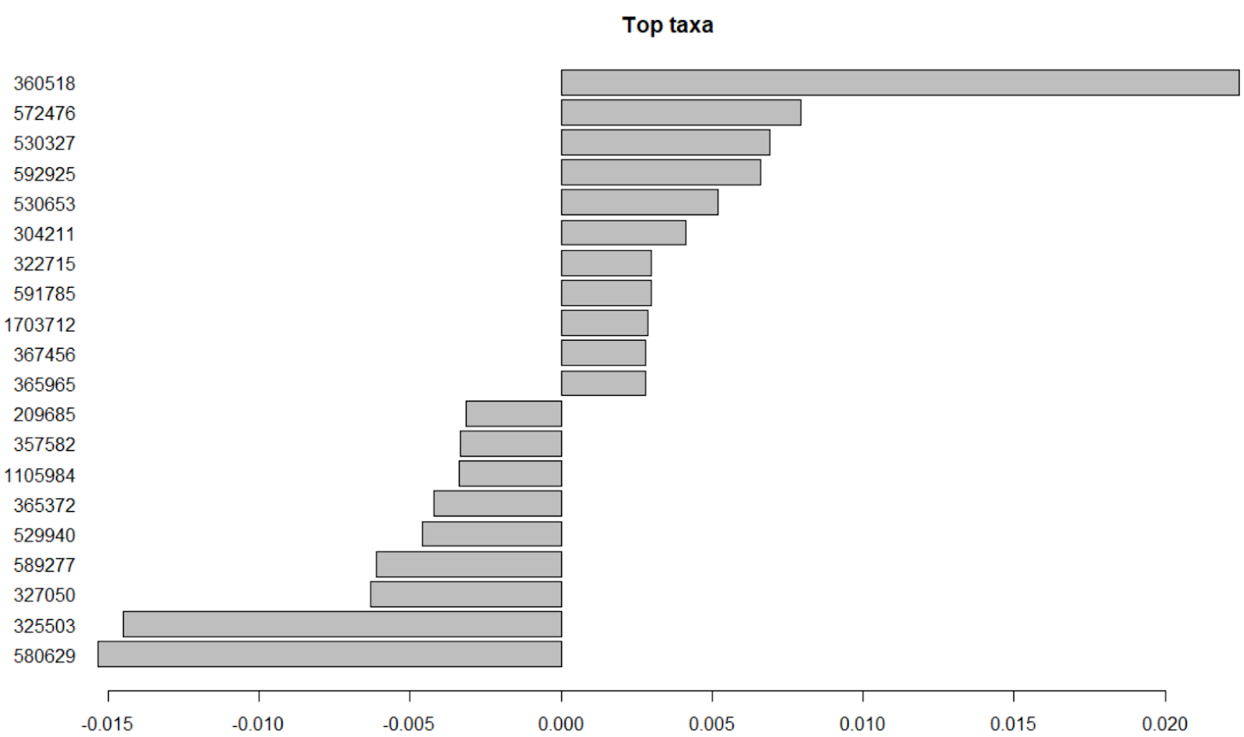
Results: 8 Excl. of outliers metagenome results
Bacteroides
Bacteroides uniformis
Faecalibacterium prausnitzii
Prevotella copri
Prevotella copri
More abundant in IR
Ruminococcus
Bacteroides eggerthii
Prevotella stercorea
Bacteroides
Blautia
Ruminococcus
Bacteroides
Bacteroides
Bacteroides
Faecalibacterium prausnitzii
Faecalibacterium prausnitzii
Less abundant in IR
Bacteroides
Bacteroides
Bacteroides
Bacteroides

Slide 21
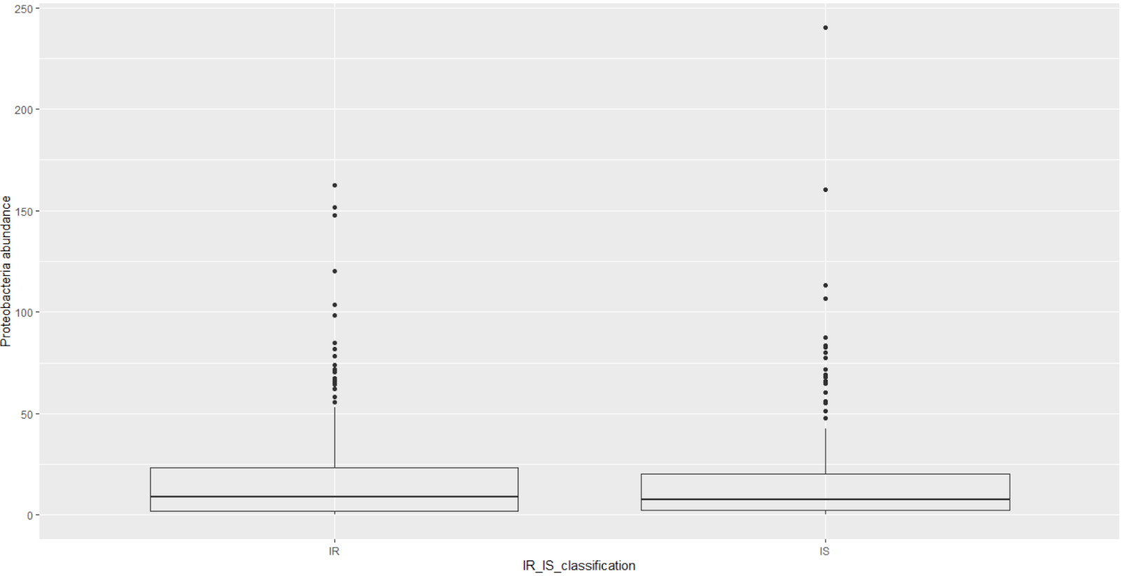
Results: 8 Excl. of outliers metagenome results
p = 0.012

Slide 22
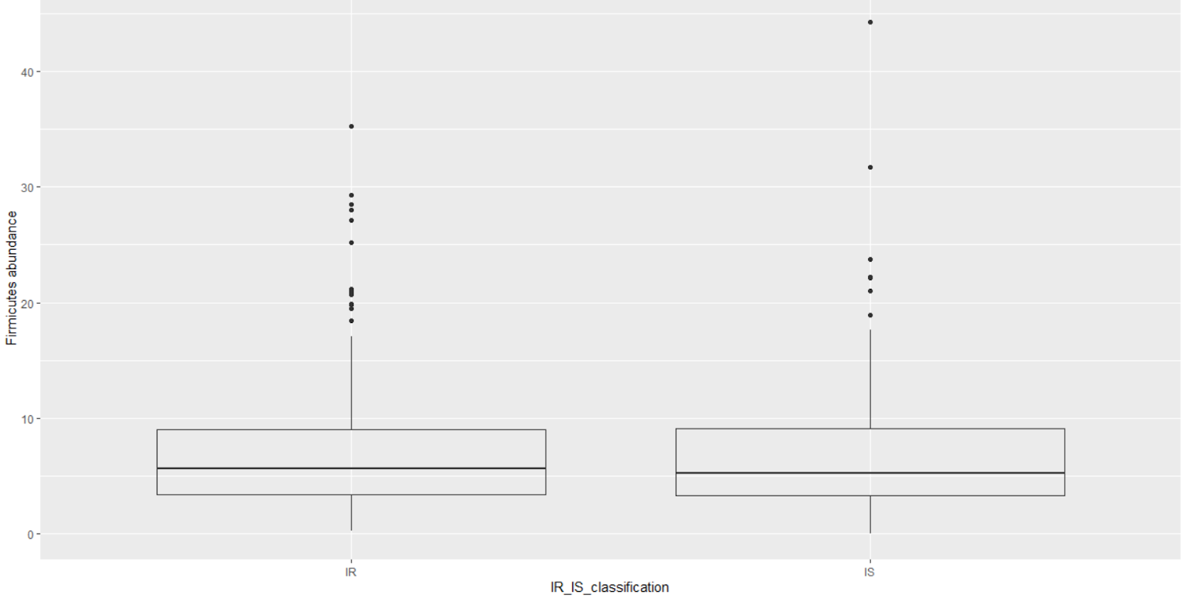
Results: 8 Excl. of outliers metagenome results
p = 5.451e-11

Slide 23
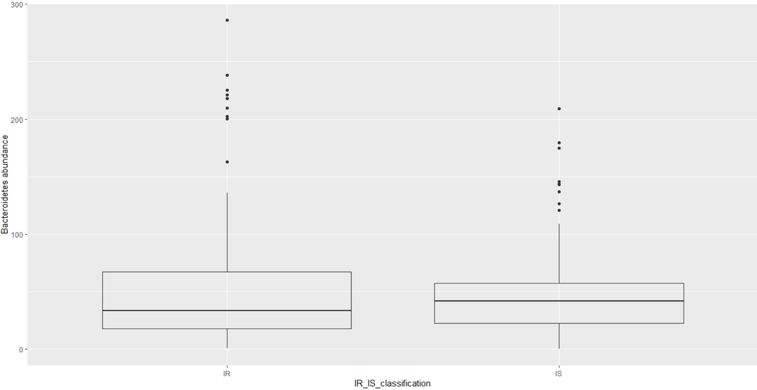
Results: 8 Excl. of outliers metagenome results
p = 0.001

Slide 24
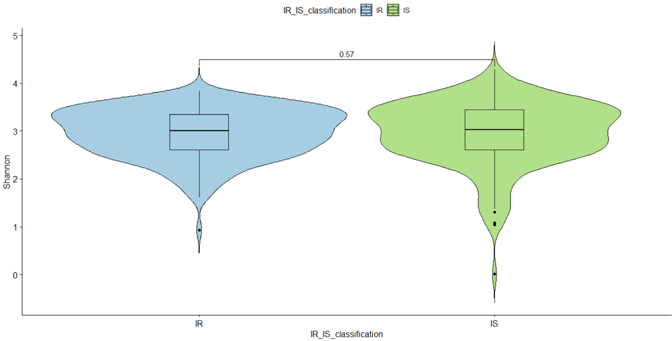
Results: 8 Excl. of outliers metagenome results

Slide 25
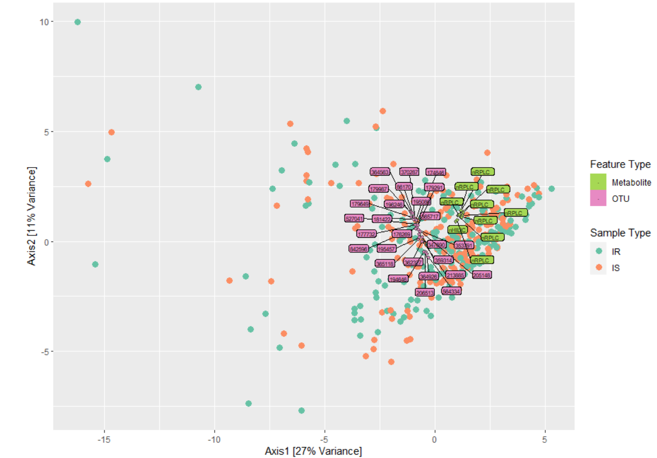
Results: 8 Excl. of outliers metagenome & metabolome results
11
CCA
27 microbes
(old = 35)
10 metabolites
(old = 12)
Correlation coefficient = 0.482
(old = 0.509)
Best explanatory features of covariation in the data of each classification

Slide 26
Next steps…
12
Complete taxon set enrichment analysis
More in depth understanding of the tests performed (e.g. PERMANOVA).
Interpretation of the results.

Slide 27
References
International Diabetes Federation. IDF Diabetes Atlas, 9th edn. Brussels, Belgium: 2019. Available at: https://www.diabetesatlas.org
American Diabetes Association. 2. Classification and diagnosis of diabetes: standards of medical care in diabetes—2019. Diabetes Care. 2019 Jan 1;42(Supplement 1):S13-28
Saisho Y. How Can We Develop More Effective Strategies for Type 2 Diabetes Mellitus Prevention? A Paradigm Shift from a Glucose-Centric to a Beta Cell-Centric Concept of Diabetes. DIABETES. 2018 Nov.
Integrative HM. The Integrative Human Microbiome Project: dynamic analysis of microbiome-host omics profiles during periods of human health and disease. Cell host & microbe. 2014 Sep 10;16(3):276.
Ferrannini E, Gastaldelli A, Iozzo P. Pathophysiology of prediabetes. Medical Clinics. 2011 Mar 1;95(2):327-39.
Guillet C, Masgrau A, Walrand S, Boirie Y. Impaired protein metabolism: interlinks between obesity, insulin resistance and inflammation. Obesity Reviews. 2012 Dec;13:51-7.
Sears DD, Hsiao G, Hsiao A, Yu JG, Courtney CH, Ofrecio JM, Chapman J, Subramaniam S. Mechanisms of human insulin resistance and thiazolidinedione-mediated insulin sensitization. Proceedings of the National Academy of Sciences. 2009 Nov 3;106(44):18745-50.
Patti ME, Butte AJ, Crunkhorn S, Cusi K, Berria R, Kashyap S, Miyazaki Y, Kohane I, Costello M, Saccone R, Landaker EJ. Coordinated reduction of genes of oxidative metabolism in humans with insulin resistance and diabetes: Potential role of PGC1 and NRF1. Proceedings of the National Academy of Sciences. 2003 Jul 8;100(14):8466-71.
Gurung M, Li Z, You H, Rodrigues R, Jump DB, Morgun A, Shulzhenko N. Role of gut microbiota in type 2 diabetes pathophysiology. EBioMedicine. 2020 Jan 1;51:102590.

